Slide 1
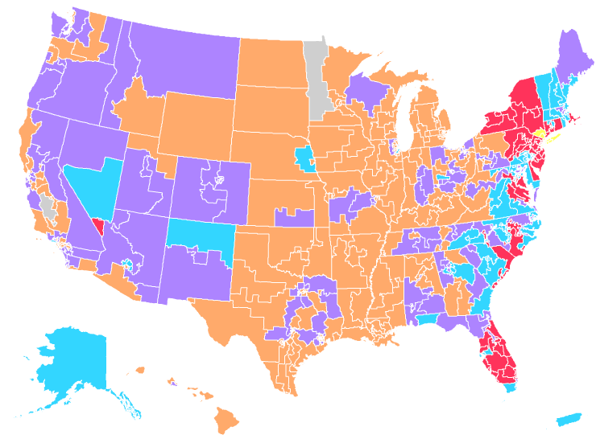
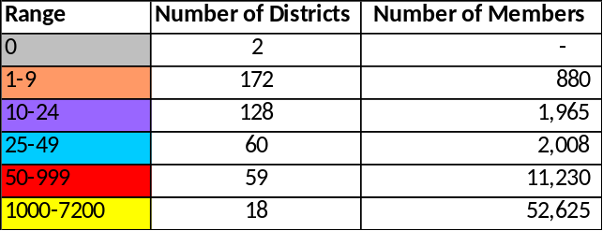
World Trade Center Health Program Total Member Distribution by 114th Congressional District
September 2015

